Slide 1
UPPER SIXTH ARTS
GEOGRAPHY
Lesson 6
Flooding
Notes:
Good morning, class, and welcome to our geography lesson. I am your geography teacher, Mr Kamdem. Today we are starting Lesson 6: Flooding.

Slide 2
CLASS INFO
Class, Chapter and Duration
Class | Upper Sixth Arts
Chapter | Module 7: Understanding and managing contemporary environmental and development issues
Duration | 2 periods (2 × 50 minutes)
Notes:
This lesson is for Upper Sixth Arts. It belongs to Module 7: Understanding and managing contemporary environmental and development issues. We shall need 2 periods to cover it.

Slide 3
IDENTIFICATION
Lesson Identification
Topic | Contemporary Environmental Issues
Sub-topic | Climate Change
Lesson | Lesson 6: Flooding
Notions / Concepts | Flood, floodplain, storm hydrograph, lag time, hard engineering, soft engineering.
Syllabus focus | Meaning and magnitude; physical and human causes; effects; adaptation and mitigation measures.
Competence | Learners are able to explain the causes and effects of floods and propose measures.
Notes:
Our topic is Contemporary Environmental Issues, and the sub-topic is Climate Change. The key notions we shall use today are: flood, floodplain, storm hydrograph, lag time, hard engineering, soft engineering. At the end, you should be able to do this: learners are able to explain the causes and effects of floods and propose measures.

Slide 4

HOMEWORK CORRECTION
Correction of the Homework
Question (Lesson 5: Global Warming):
Propose three actions your school can take to reduce greenhouse gases.
Notes:
Before we start the new lesson, let us correct the homework I gave you at the end of Lesson 5: Global Warming. The question was: Propose three actions your school can take to reduce greenhouse gases. Take out your exercise books.

Slide 5
HOMEWORK CORRECTION
Correction: Possible Answer
Examples: plant trees around the school; switch off lights and fans when not in use; stop burning rubbish and sort waste for recycling; use solar lamps.
Notes:
Here is a good answer. Examples: plant trees around the school; switch off lights and fans when not in use; stop burning rubbish and sort waste for recycling; use solar lamps. Compare it with your own answer and correct your work in red.

Slide 6
LESSON PLAN
Lesson Plan
Correction of the homework
Objectives and recall
Real-life situation and action to take
Learning activities
Board summary
Evaluation, remediation and homework
Notes:
Here is the plan of our lesson today. First, we shall correct the homework. Then we shall look at the objectives and recall what you already know. After that, we shall study a situation from real life and the action to take, and do the learning activities. Finally, we shall copy the board summary, do the evaluation and the remediation, and I will give you the homework.

Slide 7
OBJECTIVES
Objectives
By the end of this lesson, you should be able to:
Define flooding and describe its magnitude.
Explain the causes and effects of floods.
Propose measures to reduce flood damage.
Notes:
By the end of this lesson, you should be able to do three things. Number 1: define flooding and describe its magnitude. Number 2: explain the causes and effects of floods. Number 3: propose measures to reduce flood damage.

Slide 8
PREVIOUS KNOWLEDGE
Previous Knowledge
Rivers overflow in the rainy season.
Concrete does not absorb water.
Notes:
Let us first remember what you already know. Rivers overflow in the rainy season. Concrete does not absorb water. Keep this in mind, because we shall build on it today.

Slide 9
REAL-LIFE SITUATION
Situation in Real Life
Every rainy season, parts of Douala and Maroua are flooded. Houses built near rivers are destroyed, drains are blocked with rubbish and cholera spreads.
Notes:
Listen carefully to this situation from real life. Every rainy season, parts of Douala and Maroua are flooded. Houses built near rivers are destroyed, drains are blocked with rubbish and cholera spreads. Think about it, because I am going to ask you some questions.

Slide 10
REAL-LIFE SITUATION
Situation: Question 1
What is the problem in the situation?
Notes:
Question 1: What is the problem in the situation? Think for a moment, then raise your hand to answer.

Slide 11
REAL-LIFE SITUATION
Answer
Floods destroy houses and spread disease.
Notes:
Good. Floods destroy houses and spread disease.

Slide 12
REAL-LIFE SITUATION
Situation: Question 2
Give one human cause in the situation.
Notes:
Question 2: Give one human cause in the situation. Think for a moment, then raise your hand to answer.

Slide 13
REAL-LIFE SITUATION
Answer
Blocked drains (or building near rivers).
Notes:
Good. Blocked drains (or building near rivers).

Slide 14
REAL-LIFE SITUATION
Situation: Question 3
Give one effect.
Notes:
Question 3: Give one effect. Think for a moment, then raise your hand to answer.

Slide 15
REAL-LIFE SITUATION
Possible Answer
Cholera (or destroyed houses).
Notes:
Good. Cholera (or destroyed houses).

Slide 16
ACTION TO TAKE
Action to Take
Keep gutters clean and avoid building on floodplains.
Notes:
From this situation, the action we are working towards in this lesson is the following: keep gutters clean and avoid building on floodplains.

Slide 17
JUSTIFICATION
Justification of the Lesson
This lesson helps us to prevent and reduce flood damage.
Notes:
Why is this lesson important for you? This lesson helps us to prevent and reduce flood damage.

Slide 18

1. MEANING OF FLOODS
Activity 1
A flooded village.
Notes:
Activity 1. Look carefully at this picture: a flooded village. Observe every detail before I ask the question.

Slide 19
1. MEANING OF FLOODS
Activity 1: Question
What is a flood?
Notes:
Here is the question for Activity 1: What is a flood? Take one minute to think and write your answer in your rough notebook.

Slide 20
1. MEANING OF FLOODS
Activity 1: Answer
When water covers land that is normally dry.
Notes:
Let us check the answer together. When water covers land that is normally dry.

Slide 21
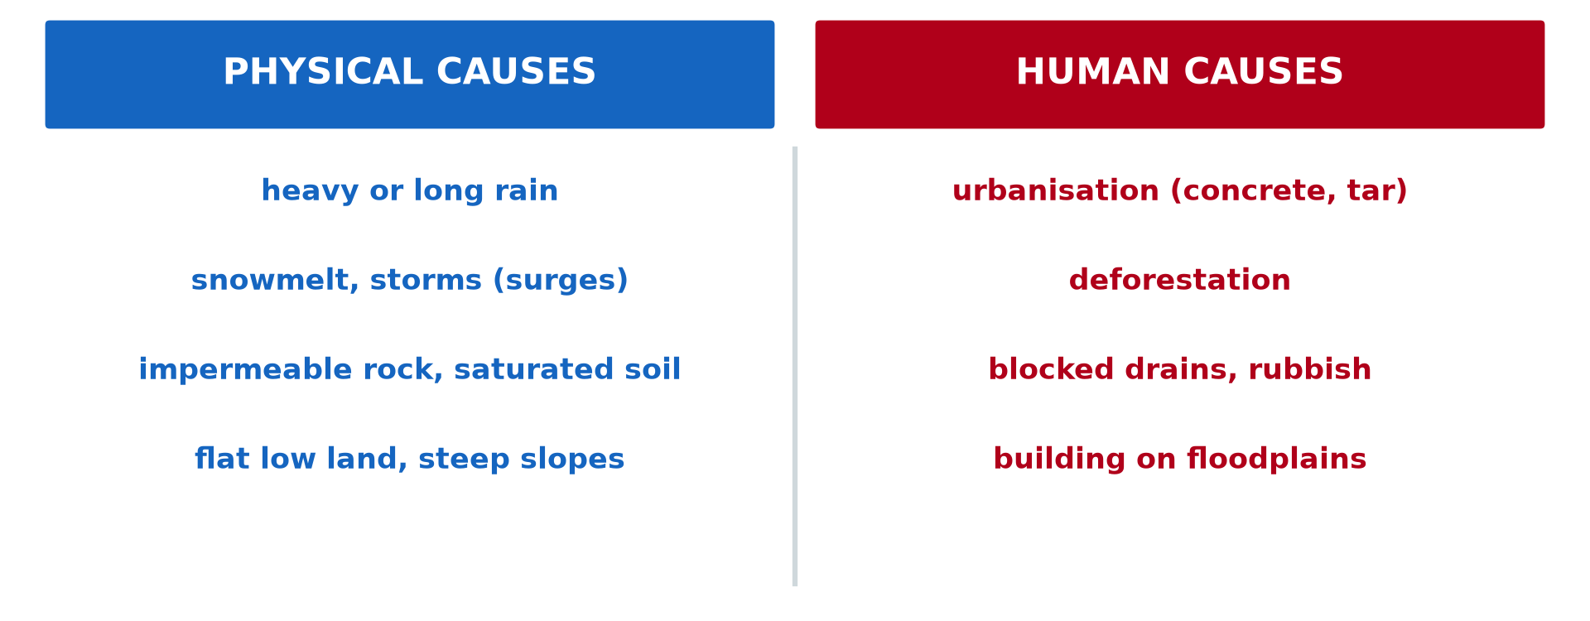
2. CAUSES OF FLOODS
Activity 2
Physical and human causes.
Notes:
Activity 2. Look carefully at this diagram: physical and human causes. Observe every detail before I ask the question.

Slide 22
2. CAUSES OF FLOODS
Activity 2: Question
Give two physical and two human causes of floods.
Notes:
Here is the question for Activity 2: Give two physical and two human causes of floods. Take one minute to think and write your answer in your rough notebook.

Slide 23
2. CAUSES OF FLOODS
Activity 2: Answer
Physical: heavy rain, saturated soil. Human: urbanisation, blocked drains.
Notes:
Let us check the answer together. Physical: heavy rain, saturated soil. Human: urbanisation, blocked drains.

Slide 24
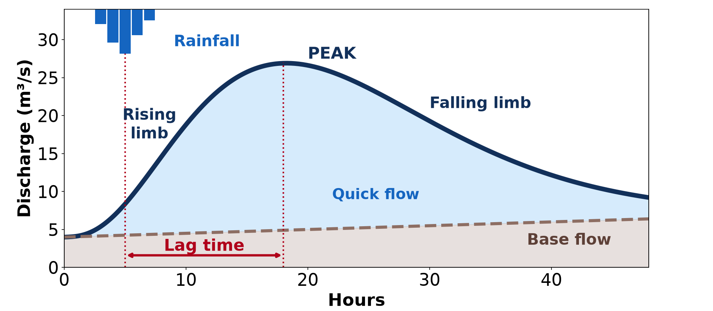
2. THE STORM HYDROGRAPH
Activity 3
A storm hydrograph.
Notes:
Activity 3. Look carefully at this diagram: a storm hydrograph. Observe every detail before I ask the question.

Slide 25
2. THE STORM HYDROGRAPH
Activity 3: Question
Why do towns have shorter lag times?
Notes:
Here is the question for Activity 3: Why do towns have shorter lag times? Take one minute to think and write your answer in your rough notebook.

Slide 26
2. THE STORM HYDROGRAPH
Activity 3: Answer
Concrete and drains send water quickly to rivers.
Notes:
Let us check the answer together. Concrete and drains send water quickly to rivers.

Slide 27

3. EFFECTS OF FLOODS
Activity 4
A flooded street.
Notes:
Activity 4. Look carefully at this picture: a flooded street. Observe every detail before I ask the question.

Slide 28
3. EFFECTS OF FLOODS
Activity 4: Question
Give three effects of floods.
Notes:
Here is the question for Activity 4: Give three effects of floods. Take one minute to think and write your answer in your rough notebook.

Slide 29
3. EFFECTS OF FLOODS
Activity 4: Answer
Loss of lives and houses, diseases and destroyed crops.
Notes:
Let us check the answer together. Loss of lives and houses, diseases and destroyed crops.

Slide 30
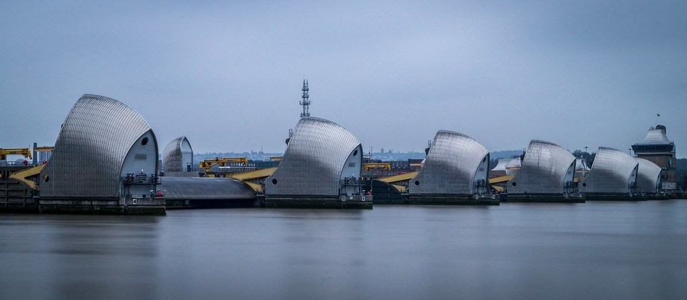
4. MEASURES
Activity 5
The Thames Barrier, London.
Notes:
Activity 5. Look carefully at this picture: the Thames Barrier, London. Observe every detail before I ask the question.

Slide 31
4. MEASURES
Activity 5: Question
Give one hard and one soft engineering measure.
Notes:
Here is the question for Activity 5: Give one hard and one soft engineering measure. Take one minute to think and write your answer in your rough notebook.

Slide 32
4. MEASURES
Activity 5: Answer
Hard: barriers, levees or dams. Soft: land-use zoning or tree planting.
Notes:
Let us check the answer together. Hard: barriers, levees or dams. Soft: land-use zoning or tree planting.

Slide 33
BOARD SUMMARY
Board Summary
Topic: Contemporary Environmental Issues
Sub-topic: Climate Change
Lesson 6: Flooding
Notes:
Now we are going to copy the board summary. Write the title and the headings neatly in your notebooks. I will give you enough time for each slide, so do not rush.

Slide 34
BOARD SUMMARY
1. Meaning and Magnitude of Floods
Floods can be defined as follows:
Flood: It is the covering of normally dry land by water. It happens when a river overflows its banks or when rain cannot drain away.
Notes:
Let us copy Meaning and Magnitude of Floods. Floods can be defined as follows. On this slide we have Flood. Write each point on a new line, with the key term first, and explain it in your own words when we revise. When you finish, we go to the next slide.

Slide 35
BOARD SUMMARY
1. Meaning and Magnitude of Floods (continued)
Floodplain: It is the flat land beside a river that is flooded from time to time. Its fertile soils attract farmers and settlements.
Notes:
We continue with Meaning and Magnitude of Floods. On this slide we have Floodplain. Write each point on a new line, with the key term first, and explain it in your own words when we revise. When you finish, we go to the next slide.

Slide 36
BOARD SUMMARY
1. Meaning and Magnitude of Floods (continued)
Magnitude: Floods range from small local floods to huge disasters like those in Bangladesh. In Cameroon, Maroua, Garoua and Douala are often flooded.
Notes:
We continue with Meaning and Magnitude of Floods. On this slide we have Magnitude. Write each point on a new line, with the key term first, and explain it in your own words when we revise.

Slide 37
BOARD SUMMARY
2. Causes of Floods
Floods have physical and human causes:
Physical causes: Heavy or long rain, saturated soils and storm surges cause floods. Flat low land and impermeable rocks flood easily.
Notes:
Let us copy Causes of Floods. Floods have physical and human causes. On this slide we have Physical causes. Write each point on a new line, with the key term first, and explain it in your own words when we revise. When you finish, we go to the next slide.

Slide 38
BOARD SUMMARY
2. Causes of Floods (continued)
Human causes: Deforestation, tarred surfaces and blocked gutters increase run-off. Building on floodplains and poor dam management add to the risk.
Notes:
We continue with Causes of Floods. On this slide we have Human causes. Write each point on a new line, with the key term first, and explain it in your own words when we revise. When you finish, we go to the next slide.

Slide 39
BOARD SUMMARY
2. Causes of Floods (continued)
Storm hydrograph: It shows the discharge of a river after a storm. Towns and bare slopes have a short lag time and a high peak, so they flood quickly.
Notes:
We continue with Causes of Floods. On this slide we have Storm hydrograph. Write each point on a new line, with the key term first, and explain it in your own words when we revise.

Slide 40
BOARD SUMMARY
2. Causes of Floods
Illustration: a storm hydrograph
Notes:
Now draw this illustration in your notebook: a storm hydrograph. Give it a title and label it clearly.

Slide 41
BOARD SUMMARY
3. Effects of Floods
Floods have the following effects:
Negative effects: Floods kill people and animals and destroy houses, crops, roads and bridges. They spread water-borne diseases like cholera.
Notes:
Let us copy Effects of Floods. Floods have the following effects. On this slide we have Negative effects. Write each point on a new line, with the key term first, and explain it in your own words when we revise. When you finish, we go to the next slide.

Slide 42
BOARD SUMMARY
3. Effects of Floods (continued)
Positive effects: Floods deposit fertile alluvium on floodplains. They also recharge groundwater and fill lakes.
Notes:
We continue with Effects of Floods. On this slide we have Positive effects. Write each point on a new line, with the key term first, and explain it in your own words when we revise.

Slide 43
BOARD SUMMARY
4. Adaptation and Mitigation Measures
Floods are controlled by the following measures:
Hard engineering: Dams, levees, barriers and wider channels hold back water. They are costly but protect towns, as the Thames Barrier protects London.
Notes:
Let us copy Adaptation and Mitigation Measures. Floods are controlled by the following measures. On this slide we have Hard engineering. Write each point on a new line, with the key term first, and explain it in your own words when we revise. When you finish, we go to the next slide.

Slide 44
BOARD SUMMARY
4. Adaptation and Mitigation Measures (continued)
Soft engineering: Land-use planning, afforestation and flood warnings reduce damage. They are cheaper and better for the environment.
Notes:
We continue with Adaptation and Mitigation Measures. On this slide we have Soft engineering. Write each point on a new line, with the key term first, and explain it in your own words when we revise.

Slide 45
FORMATIVE EVALUATION
Evaluation 1
Give two causes of urban floods.
Notes:
Now let us check what you have understood. Question 1: Give two causes of urban floods. Answer in your exercise book.

Slide 46
FORMATIVE EVALUATION
Expected Answer
Concrete surfaces and blocked drains.
Notes:
The expected answer is: concrete surfaces and blocked drains. If you got it right, well done.

Slide 47
FORMATIVE EVALUATION
Evaluation 2
Compare hard and soft engineering.
Notes:
Now let us check what you have understood. Question 2: Compare hard and soft engineering. Answer in your exercise book.

Slide 48
FORMATIVE EVALUATION
Expected Answer
Hard: costly structures. Soft: cheaper natural methods and planning.
Notes:
The expected answer is: hard: costly structures. Soft: cheaper natural methods and planning. If you got it right, well done.

Slide 49
REMEDIATION
Remediation
Fill in the blanks:
Flat land beside a river is a ______.
Walls built along rivers are ______.
Planning where to build is land-use ______.
Notes:
For those who need more practice, fill in the blanks in your exercise book. The answers are: number 1, floodplain; number 2, levees; number 3, zoning.

Slide 50
HOMEWORK
Homework
Map the flood-prone areas of your town and suggest two solutions.
Notes:
For your homework: Map the flood-prone areas of your town and suggest two solutions. We shall correct it at the beginning of our next lesson.

Slide 51
NEXT LESSON
Next Lesson
Our next lesson will be on:
Lesson 7: Notion of Development
Notes:
Our next lesson will be on Lesson 7: Notion of Development. Thank you for your attention, and see you next time.

Slide 52
BILINGUAL GAME
Bilingual Game (Jeu Bilingue)
English | Français
Flood | L'inondation
Drain | Le caniveau
Dam | Le barrage
Levee | La digue
Warning | L'alerte
Floodplain | La plaine d'inondation
Notes:
Let us play the bilingual game. I say a word in English, and you give me the French word. Then we do the reverse.

Slide 53
LOGBOOK
Official Logbook (1/2)
Module / Topic | Contemporary Environmental Issues
Lesson Title | Lesson 6: Flooding
Expected Learning Outcomes | Define flooding and describe its magnitude. Explain the causes and effects of floods. Propose measures to reduce flood damage.
Competence | Learners are able to explain the causes and effects of floods and propose measures.
Notes:
I record this information in the official logbook of the class after the lesson.

Slide 54
LOGBOOK
Official Logbook (2/2)
Matter Taught | Meaning and Magnitude of Floods; Causes of Floods; Effects of Floods; Adaptation and Mitigation Measures.
Evaluation | Formative evaluation and remediation exercise.
Homework | Map the flood-prone areas of your town and suggest two solutions.
Enrolment / Present / Absent | ____ / ____ / ____
Achievement | To be completed after the lesson.
Notes:
I complete the second page of the logbook: the matter taught, the evaluation, the homework and the attendance.

Slide 55
TEACHER'S NOTE
Teacher's Note
Timing: Homework correction, plan, objectives 8 min | Recall, situation, action 10 min | 5 activities 30 min | Board summary (copying) 30 min | Evaluation, remediation 10 min | Homework, next lesson 5 min | Logbook 7 min
Without the projector (Activity 1): describe a flood you saw.
Without the projector (Activity 2): sort causes.
Without the projector (Activity 3): read the lag time.
Without the projector (Activity 4): list effects.
Without the projector (Activity 5): suggest measures for your town.
Notes:
This slide is for me, the teacher: it gives the timing of the lesson and what to do if the projector is not available.

Slide 56
REFERENCES
References
National Geography Syllabus, MINESEC/IGE/IP-SS, 2019 — Module 7 (Environment and Development).
Photo, Activity 1: “Flood in Accra” by Stig Nygaard, CC BY 2.0, via Flickr (https://www.flickr.com/photos/10259776@N00/181742000)
Photo, Activity 4: “Vicenza flooding Nov.1, 2010” by US Army Africa, CC BY 2.0, via Flickr (https://www.flickr.com/photos/36281822@N08/5157191333)
Photo, Activity 5: “Thames Barrier” by dolbinator1000, CC BY 2.0, via Flickr (https://www.flickr.com/photos/126654539@N08/32983498011)
Diagrams and animations: drawn for this lesson (Geography Department).
Notes:
These are the references and picture credits used to prepare this lesson.

